Slide 1
The Bread Blue Project
SKK GSB FMBA
Adrien Long, Dami Choi, Jeong Min Hong, Lee Jang Hyun, Nikki

Slide 2
Executive Summary:
Costumer’s behaviour analysis based on real survey,
Vegan food market trend analysis in Korea,
Vegan food competitors analysis of bread blue,
Marketing channels and Distributions Channels with financial projections.
Key Findings:
Introduction of new vegan food varieties to differentiate,
Affordable and effective marketing strategies,
Distribution channel strategies,
Reasonable suggestions to emerge as a healthy and sustainable vegan food brand not limited to just bakery to create brand equity with next 3 years timeline.
Recommendations:

Slide 3
Topics we’ve been addressing
Problems
- What is the trend and current status of the vegan market in Korea?
- How The Bread Blue is differentiated from other competitors?
- What strategies or efforts should The Bread Blue work out to position themselves strongly among other vegan bakeries?
How did we approach it?
-Research studies of the vegan market trend domestically and internationally.
-Learn the behavior of a target customer to understand key factors when buying a vegan products.
-Benchmarked developed vegan market’s vegan brand’s marketing strategy
Solution
-Design a new marketing strategy positioning the bread blue distinguished from other competitors.
-Adding new value and new association with the brand to strengthen brand equity

Slide 4
Defining the vegan market in Korea
Why does a vegan bakery make sense?
Bread is seen differently in Korea compared to other countries.
Traditionally bread was considered as a vegan to the majority of Westerners.
HOWEVER in Korea, bread is normally made with milk and butter,
Koreans naturally recognize bread as a non-vegan food item.

Slide 5
Current Market Status
Vegan Market Trend | The Bread Blue’s Current Strategy
Vegan Market is growing fast due to increased growth of flexitarian market. | Mostly focused on strict vegan, vegetarian, and lactose intolerant.
Especially non-dairy products and meat substitutes are growing segments. | Bread Blue products are non-dairy items.
The increasing demand for vegan products is due to interest in healthy nutrition and environmental care issues. | Emphasis on using only vegan-based ingredients to ensure a healthy brand image to consumers.
The rising interest of animal rights and environmental issue is driving demand of vegan food. | Not much associations with the other vegan societies regarding brand concept of the Bread Blue.
Korea Market’s response to flexitarian; vegetarian ready-to-eat meals and vegetarian desserts. | The majority products are general breads.

Slide 6
The Problem and Brief Suggestions
Market Trend | The Bread Blue’s Current Strategy
Vegan Market is growing fast due to increased growth of flexitarian growth | Mostly focused on strict vegan, vegetarian, and lactose intolerant
Especially non-dairy products and meat substitutes is growing segment | All of products are non-dairy based
The increasing demand for vegan products is due to Interest in healthy nutrition | Emphasis on using only vegan-based ingredients to ensure a healthy brand image to consumers
The rising interest of animal rights and environmental issue is driving demand of vegan food | Not so much association with the brand concept of the bread blue
Korea Market’s response to Flexitarian ; vegetarian ready-to-eat meals and vegetarian desserts | The majority of products are general bread
1. Target Segment should be prioritized to Flexitarians.
2. The current brand concept is in accordance with consumer’s expectation on vegan food;
a strong connection to a healthy brand concept is recommended.
3. Associating with animal welfare right & environmental issue would be helpful in
improving the brand’s image and creating brand equity.
4. Development of more Ready-to-Eat Meals and Desserts is needed.

Slide 7
The Project’s Mission
As-Is
To-Be
One of a vegan bakery focused on vegans.
Marketing efforts cannot reach out to mass market.
Loss chances to introduce vegan food to general consumers.
The vegan brand embracing vegan, vegetarian, flexitarian and general consumers interested in healthy food.
Utilize diverse marketing tools to introduce the brand as strong vegan food brand.
Position as the representative vegan brand in Korea.
Aimed to position The Bread Blue as the market leader in Vegan Food Market
by implementing new marketing strategies.

Slide 8
Marketing Strategy

Slide 9
Segmentation and Targeting
Flexitarian
Consumers eating vegan food
from time to time.
…
Consumers on a diet.
…
Consumers with interest in animal right/environmental issues.
…
Consumers seeking for healthy nutrition alternatives.
...
Vegan
Vegetarian
Lactose Intolerant
Notes:
even if TBB is vegan bakery, we are not focusing mainly on vegan.
As vegan are still small part of population, we will focus flexitarian who have interest in healthy food

Slide 10














New Positioning
Variety
1
1
3
Mass
Market
With
High
Variety
Provides a wide range of vegan food
Doesn’t target only vegans but also people who are interested in eating healthy food
The Bread Blue
2
Yummyyomeal
Mass
Market
With
Low
variety
Provides limited vegan food category
Focused on certain food category
Targets general customers who are interested in eating healthy food
Soul Bread
Mass Market
Exclusive to
Vegan
Pan Honesta
Magnut
3
4
Focused on targeting vegan/vegetarian customers
Popular among neighbors but not well known to the public
Vegan
Oriented
Market
Mud Scone
2
4
Notes:
We defined the positioning of TBB on 2 parameters : variety and how exclusive they are targeting vegan customers.
4 different categories : TBB is on the high left. their positioning is based on not targeting only vegan but also non-vegan such as flexitarian while providing many different products.
That’s the way they can differentiate themselves against other competitors who are more focused on vegan customer.
TBB has no specific advantage over other competitors in that area, they just want to be the first well established player

Slide 11
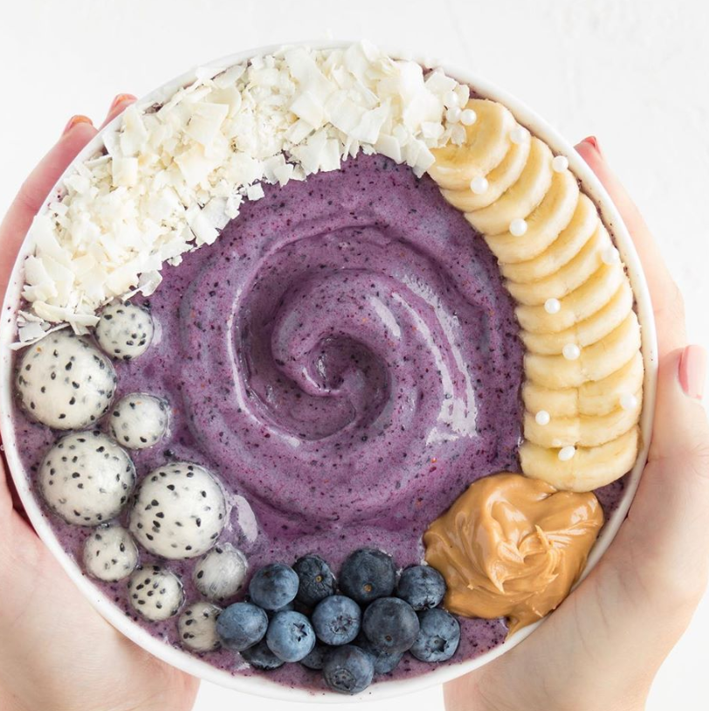
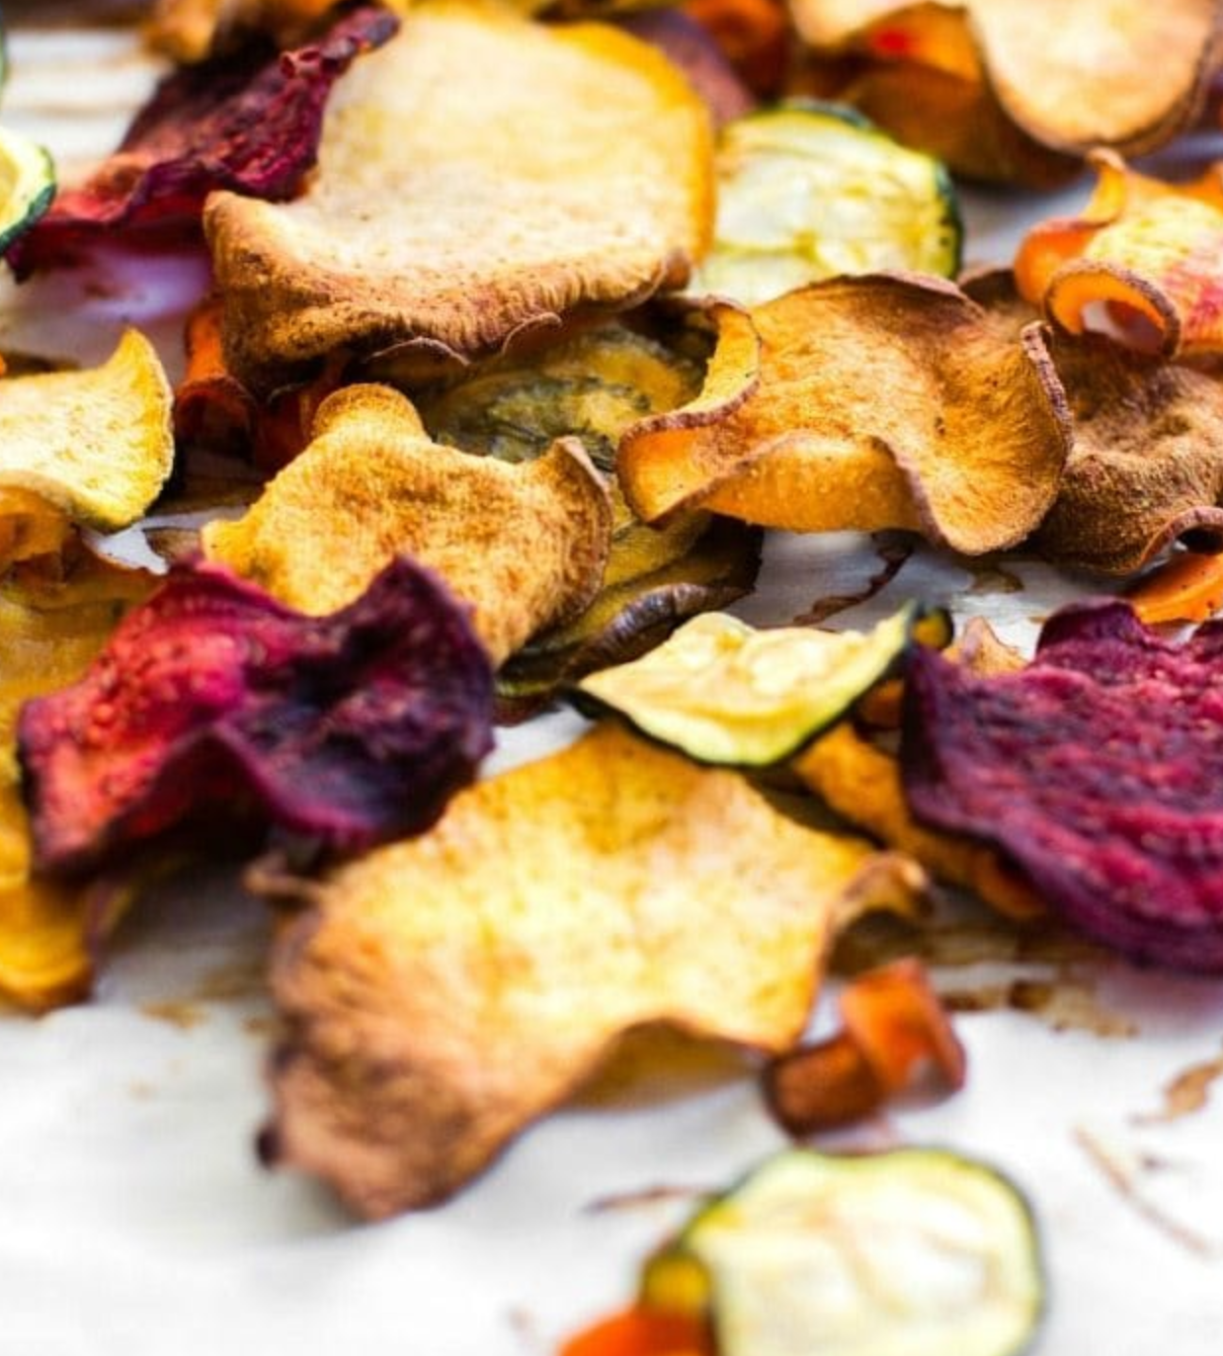
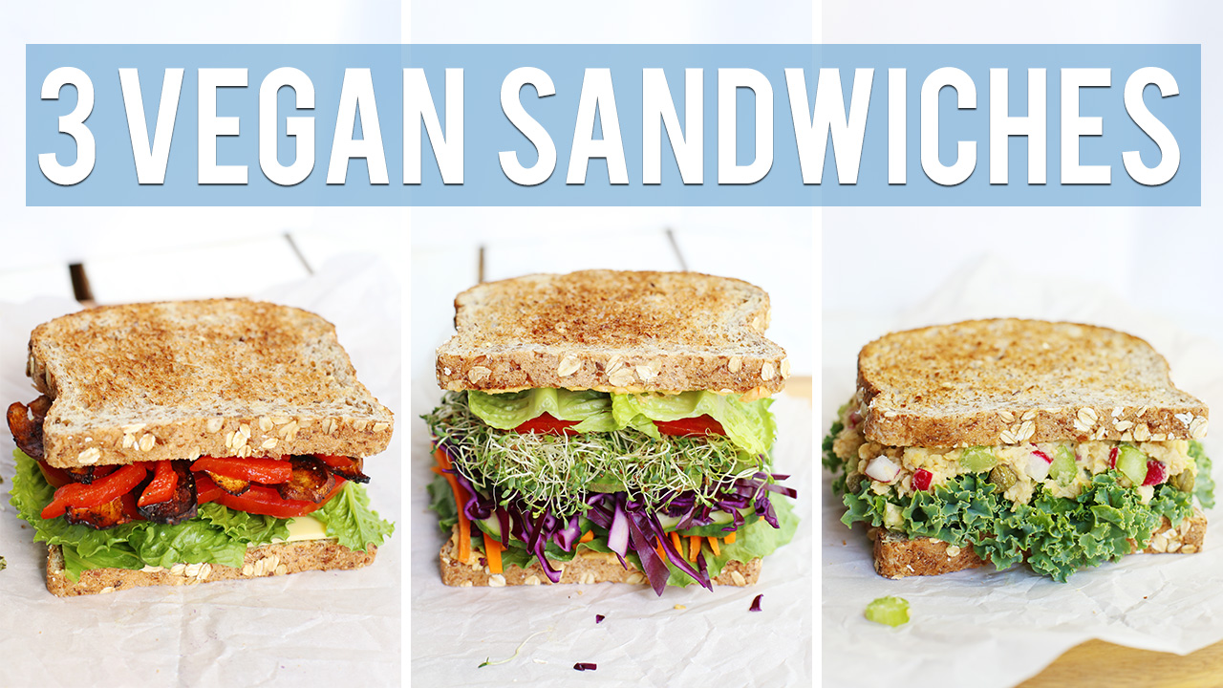
Product Strategy
Non-dairy Milks, Cheeses
Vegan Dessert
Frozen non-dairy yogurt
Veggie Chips Oil Free Baked Veggie Chips
Vegan pack-meal
Vegan Sandwich + Vegan Dessert
Vegan Hamburger + Vegan Dessert
Vegan Dumpling / Vegan Sushi
Notes:
Because TBB is focusing on flexitarian, we recommend to provide popular food such as vegan milk or cheese, or again vegan dessert
Lately the meal package we can find in the convenient store are quite popular, so that’s another option we recommend
Our product would be higher quality compared to these usual package from convenient store and a little more expensive as our customers are less price sensitive

Slide 12
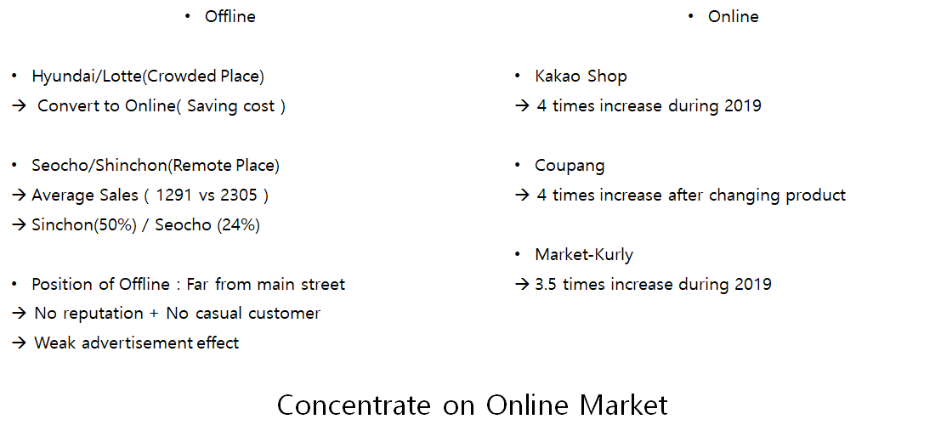
Place Strategy
Induce offline consumers to visit the bread blue website!
Notes:
location strategy
even in crowded place like hyunday and lotte departement , physical shop failed to be successful. they then converted to online store
if we compared the growth, iactually online store are increasing much more compared to offline store
we want to focus on online store. also it’s not affected by corona. closing offline can be viewed as a bad situation but it can be a chance to refocus on online store

Slide 13
Place Strategy
Inducing to introduce the brand to friends/family/colleagues
Give extra points to a new customer and to the referees.
Practice a marketing events inviting loyal customers with their acquaintance.
Give 10k won discount if friend or family get the membership.
Provides family-friendly events.
Inducing to buy the product repeatedly
Initiate Membership System on the bread blue’s official website.
Give the membership card in offlines stores that requires customers to activate membership through the website.
Give same item with 25% discount if you made a post on it on SMN (#vegan).
Give discount if coming several days in a row (1 week in a row -> -5%/ 2 weeks->7%).
Trial of the product
Provide a free sample of new SKUs to those who bought the product from either online or offline.
Provide 50% discount coupons to those who never bought product through the website.
give option to try the product inside the store.
Inducing to visit the online offline store / cognitive of the brand
Use Instagram / youtube/facebook channel to advertise the brand and to facilitate inflow to new customers.
Make events with community manager on specific day with SMN coverage.
Notes:
Here is all different marketing strategy to enhance the sales for TBB, there is 4 steps in this order. we will talk more on details about these later
As said we will focus specially on online strategy

Slide 14
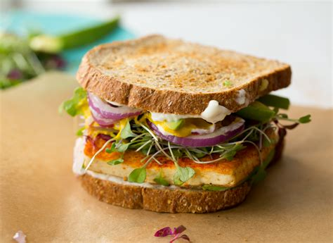
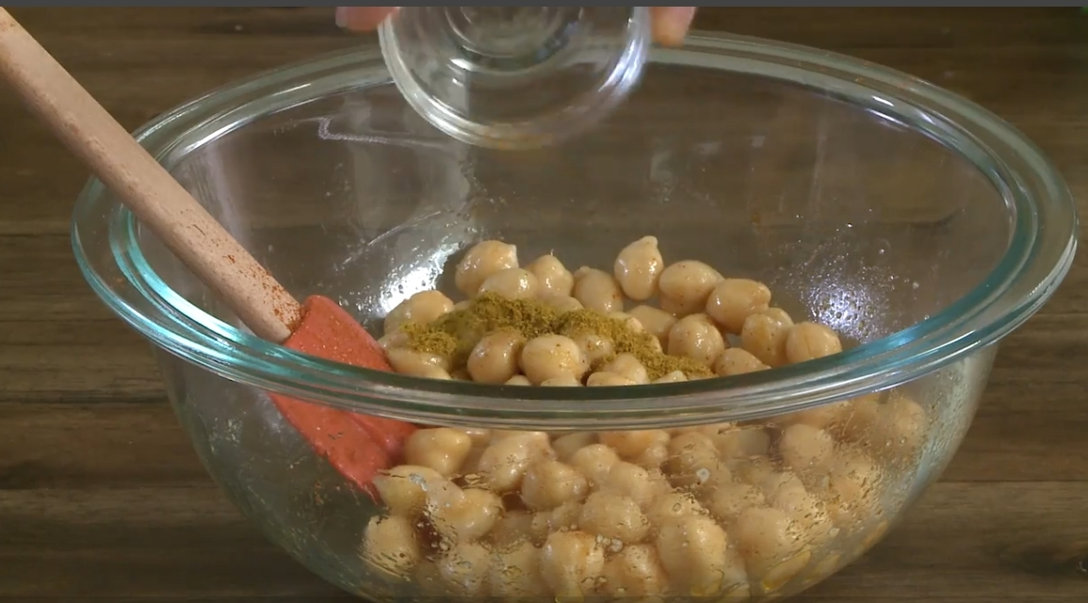
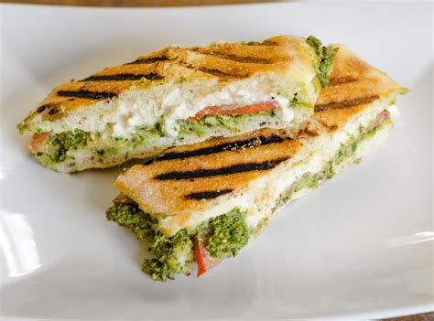
Promotion Strategy _ Online
Post contents on social media that intrigue interest to the audience
and let them engage with the contents
Contents Strategy
1. Newsworthy
Sharing recipe video clip using the Bread Blue’s product
Posting contents that demonstrate benefits of eating vegan food
2. Promotional
Sharing sales coupon that could be used on the bread blue’s exclusive sales channel
Alarming a promotion event to the audience
Notes:
concerning online strategy 2 ways to increase awareness: sharing newsworthy content -> very good because it will create a community around the TBB brand, they will share recipe and interact all between them
the promotional part is more standard in terms of marketing

Slide 15



Promotion Strategy _ Online
Design video contents with Youtube Influencer in accordance with topic that Influencer is addressing
Bread Mukbang (Eating-show) Youtube Channel
Introduce the bread blue’s diversified products to people having interest in eating healthy breads.
Daily routine vlog Youtube Channel
Dissolve the product within the daily life of Youtuber naturally to deliver that the brand is popular among influencers seeking “Eat well, live better” life style.
Diet for weight-loss Youtube Channel
Introduce the products to people seeking for a bread that does not harm their weight loss achievement.
Notes:
there is different ways of promoting on youtube channel, we chose different influencer, maybe you heard about mukbang videos?
these video show someone eating very large amount of food and commenting about it .
Design the video content in function of the topic

Slide 16
Price Strategy
Behavior of consumers
High willingness to pay for healthy foods + Price insensitive when buying healthy food items.
New Customers
Provide 30%~50% discount coupons to new customers that could be used for their initial purchase
Current Customers
Provide free samples or free trial products that are beneficial to health
Other Innovative Discounts
Value Pack
Selling remnant with discounts
Provide a voucher that can be exchanged to buying bread blue products.
(ex; If a customer bought more than 50,000 KRW, the bread blue provides a value of 5,000 KRW voucher that can be used from their next visit)
Maintain current mid-high price range giving promotion and discount from time to time
Notes:
behavior consumer of or target customer is characterized by high willingness to pay
maintain high price
give promotion and discount time to time

Slide 17
Brand Strategy

Slide 18
Core Identity
Strengthen the bread blue’s brand identity by delivering brand message :
Dedicated to your wellness and to our planet
TASTE
Our mission is to satisfy your appetite with healthy vegan food
HEALTHY
We offer tasty plant-based food using organic ingredients
PLANET
We have genuine concern for all living beings and the environment - and we support it by our animal-friendly products

Slide 19

Promotion Strategy _ Online
Initiate a campaign to associate brand with a sponsorship to NPOs
100 Likes = 100,000 KRW donation
Products of the bread blue = Animal-friendly / Eco-friendly
For every like in May, the bread blue will donate 1000 KRW to *** organization, up to 100,000 KRW

Slide 20
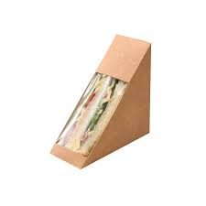
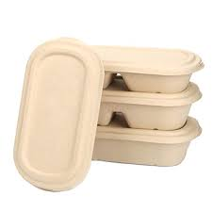
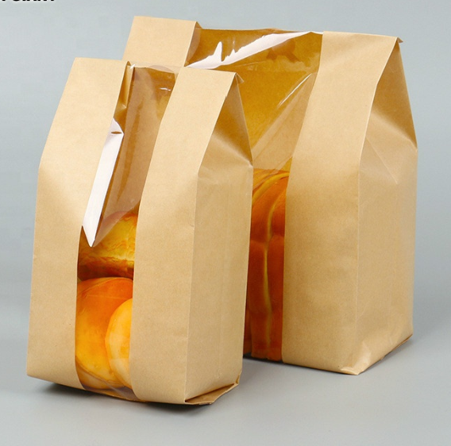
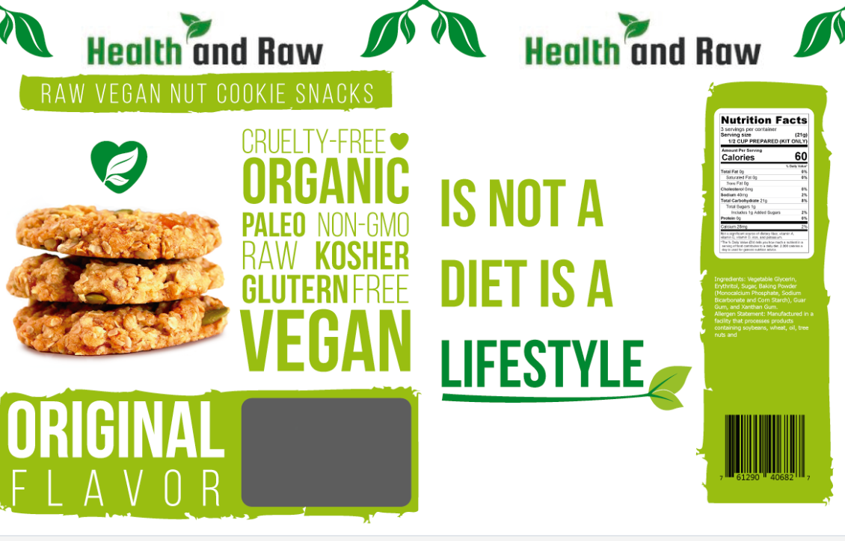
Activities to strengthen the Brand Identity
Packaging for strengthening the brand identity
Use paper bags, environment-friendly packages
Vinyl Bag > Paper Bag, PE-Woven Bag (paper material used for rice bags)
Ice-pack made with water and starch material
Highlight ingredients names on packaging for all online/take-home offline deliveries.
Highlight words like vegan, go green & healthy on packaging.

Slide 21
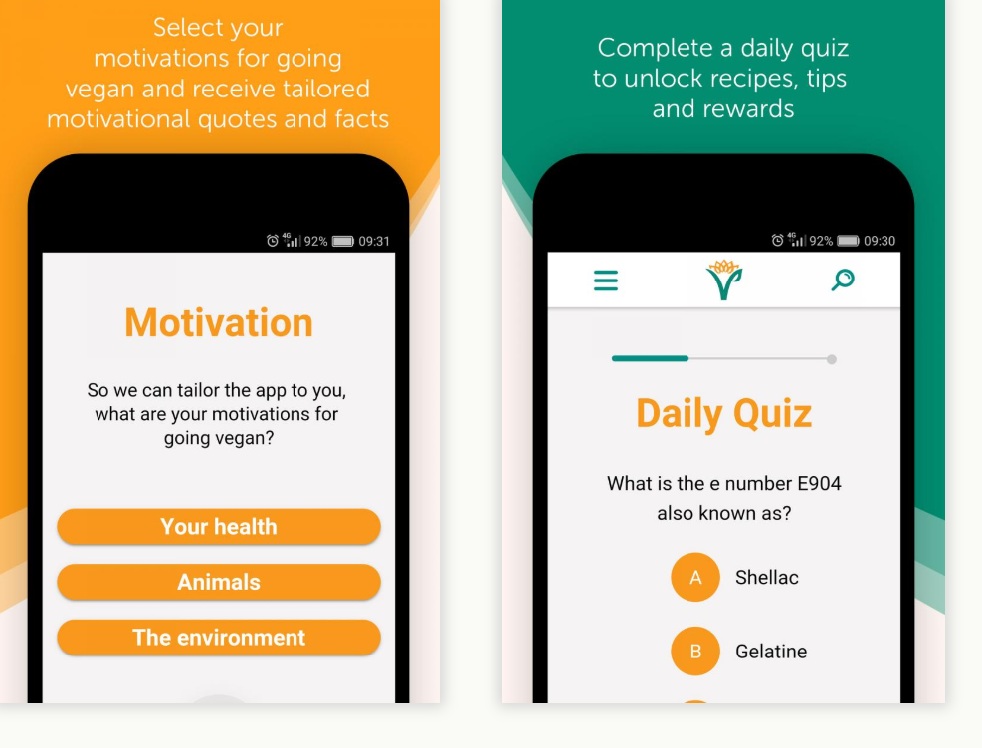
Activities to strengthen the Brand Identity
Promoting knowledge of sound nutrition and interest in veganism as a complete and healthy diet.
This is achieved through a strong online presence, social and traditional media, the Vegan Trademark for vegan products and services and long-standing partnerships with like-minded organisations.
Collaborate with some of famous Korean Vegan facebook pages are
Vegan Korea · 채식, Seoul Veggie Club, Pragmatic Vegans in Korea
Go live to Motivate customers for Health, Animals and Environment,
put daily quiz provide rewards for online/offline stores and
answers theirs doubts about veganism or Bread Blue.

Slide 22
Timeline AND Expected Results

Slide 23
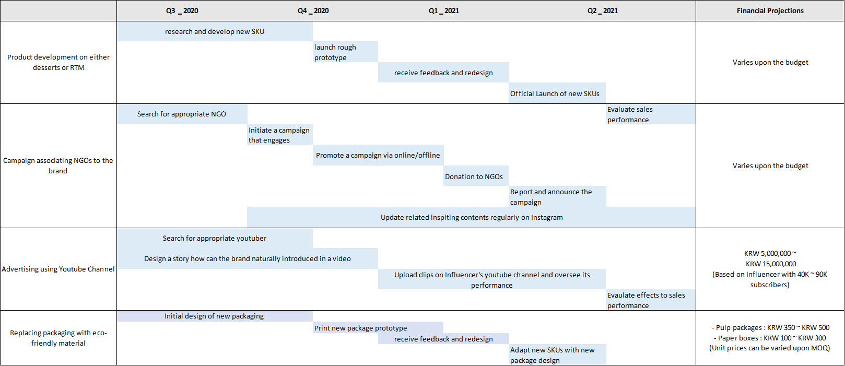
Timeline for Key Projects

Slide 24
Expected Results
Brand equity will rise due to the bread blue distinguished brand identity differentiated by a strong commitment to social value and association with NGOs
The brand identity of the bread blue would be differentiated from other competitors by a variety of products(SKUs) it offers and how it engages non-vegetarian
Consumers from offline stores will be likely to buy products from the online store as well
Retention rate and re-purchasing rate will increase due to its membership and offering it gives to loyal customers

Slide 25

Questions & Answers

